Slide 1
Automate a business process using Power Automate
Notes:
Link: https://docs.microsoft.com/en-us/learn/modules/flow-get-started/

Slide 2
Agenda
Get started with Power Automate
Build more complex flows with Power Automate
Introduction to expression in Power Automate

Slide 3

Microsoft PL-400 Collection on Learn
Collections - MSFTofficialCurriculum-4292 | Microsoft Learn
Notes:
Link to student courseware on Learn
https://learn.microsoft.com/en-us/users/msftofficialcurriculum-4292/collections/zwm5c41m26jp0q

Slide 4

Get started with Power Automate

Slide 5
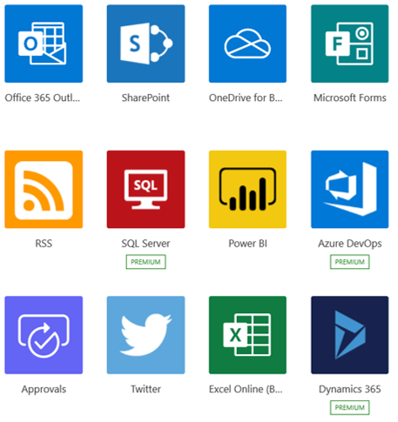
What is Power Automate?
Power Automate is an online workflow service that automates actions across the most common apps and services
Notes:
Power Automate is an online workflow service that automates actions across the most common apps and services. For example, you can create a flow that adds a lead to Microsoft Dynamics 365 and a row in MailChimp whenever someone with more than 100 followers tweets about your company.
When you sign up, you can connect to more than 220 services, and can manage data either in the cloud or in on-premises sources like SharePoint and Microsoft SQL Server. The list of applications you can use with Power Automate grows constantly.

Slide 6
What can you do with Power Automate?
Use Power Automate to automate workflows between your favorite applications and services, sync files, get notifications, collect data, and much more
For example, you can automate these tasks:
Instantly respond to high-priority notifications or emails
Capture, track, and follow up with new sales leads
Copy all email attachments to your OneDrive for Business account
Collect data about your business, and share that information with your team
Automate approval workflows
Notes:
You can use Power Automate to automate workflows between your favorite applications and services, sync files, get notifications, collect data, and much more.
For example, you can automate these tasks:
Instantly respond to high-priority notifications or emails.
Capture, track, and follow up with new sales leads.
Copy all email attachments to your OneDrive for Business account.
Collect data about your business, and share that information with your team.
Automate approval workflows.
A common use of Power Automate is to receive notifications. For example, you can instantly receive an email or a push notification on your phone whenever a sales lead is added to Dynamics 365 or Salesforce.

Slide 7
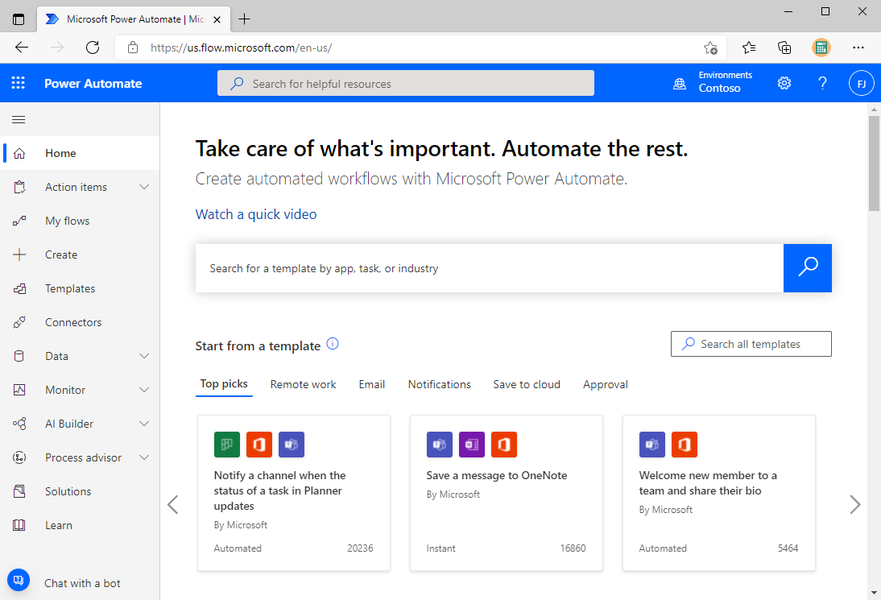
A brief tour of Power Automate
Flows can be created from: Make.powerapps.com
Notes:
https://www.microsoft.com/en-us/videoplayer/embed/RWGzz0?postJsllMsg=true
Let's jump into Power Automate, and we'll show you around. We have tons of information for you to learn about how to use Power Automate.
When you sign in to Power Automate, you'll find these menus:
Action items, where you can manage approvals My flows, where your flows reside.
Create, where you start a new flow.
Templates, where you can take a look at some of the most popular templates. These should give you some great ideas for flows you want to try.
Connectors, where you can connect from one service to another.
Data, where you can access tables, connections, custom connectors and gateways.
Solutions, where you can manage your solutions.
Learn, where you can find information that will help you quickly ramp up on Power Automate.
For now, let's focus on the ? menu next to your login, which has these options:
Documentation is where our advanced topics reside. If you want to really understand a feature or function, you can do a deep dive here to figure things out.
Learn has learning paths to guide you through using Power Automate, all the way from beginning techniques to advanced scenarios.
Support is a great landing place to find help.
Roadmap is where you can get a glimpse into what will be made in the next product update.
Community is a place to plug into and find out how other people use Power Automate.
Give Feedback taps into a community of power users, and is where you can send comments and questions to developers and other experienced users.
Blog keeps you up to date about the most recent developments and releases in the Power Automate ecosystem.
Pricing can help you choose the right plan for you or your business.

Slide 8
Power Automate screen
When you sign into Power Automate, you’ll find these menus:
Action items: Where you manage approvals
My flows: Where your flows reside
Create: Where you start a new flow
Templates: Where you can look at popular templates
Connectors: Where you can connect from one service to another
Data: Where you can access tables, connections, custom connectors and gateways
Solutions: Where you can manage your solutions
Notes:
You can use Power Automate to automate workflows between your favorite applications and services, sync files, get notifications, collect data, and much more.
For example, you can automate these tasks:
Instantly respond to high-priority notifications or emails.
Capture, track, and follow up with new sales leads.
Copy all email attachments to your OneDrive for Business account.
Collect data about your business, and share that information with your team.
Automate approval workflows.
A common use of Power Automate is to receive notifications. For example, you can instantly receive an email or a push notification on your phone whenever a sales lead is added to Dynamics 365 or Salesforce.
Action items, where you can manage approvals
My flows, where your flows reside.
Create, where you start a new flow.
Templates, where you can take a look at some of the most popular templates. These should give you some great ideas for flows you want to try.
Connectors, where you can connect from one service to another.
Data, where you can access entities, connections, custom connectors and gateways.
Monitor, where you can view the activity of all your cloud and desktop flows.
AI Builder, where you can build AI models and view the models you created or that have been shared with you.
Process advisor, where you can create processes to help your organization better understand places to streamline workflows.
Solutions, where you can manage your solutions.
Learn, where you can find information that will help you quickly ramp up on Power Automate.
For now, let's focus on the ? menu next to your login, which has these options:
Documentation is where our advanced topics reside. If you want to really understand a feature or function, you can do a deep dive here to figure things out.
Learn has learning paths to guide you through using Power Automate, all the way from beginning techniques to advanced scenarios.
Support is a great landing place to find help.
Roadmap is where you can get a glimpse into what will be made in the next product update.
Community is a place to plug into and find out how other people use Power Automate.
Give Feedback taps into a community of power users, and is where you can send comments and questions to developers and other experienced users.
Blog keeps you up to date about the most recent developments and releases in the Power Automate ecosystem.
Desktop flows provides an introduction to Power Automate Desktop.
Pricing can help you choose the right plan for you or your business.
Power Automate Desktop is where you can download Power Automate Desktop and install it on your machine.
Power Automate for Mobile provides information about the mobile app and the platforms it is available on.
Data Gateway provides an overview of the on-premises data gateway.

Slide 9
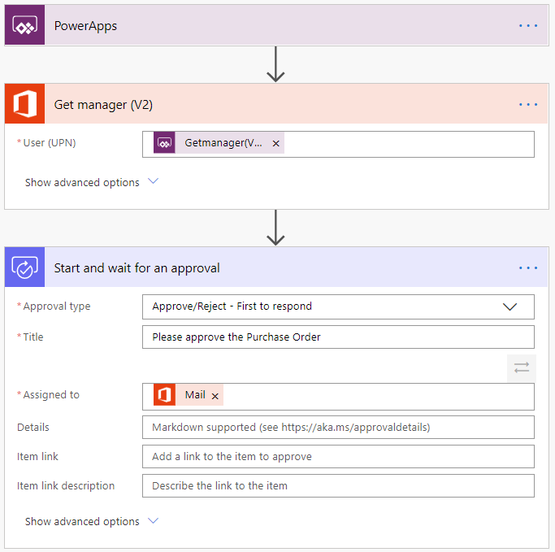
Example: Purchase order approval
Notes:
Approvals are a great process to build in Power Automate. They are often defined yet manual. Check out the following scenario for an example:
A user starts the process by going into a Power Apps app and creating a purchase order request. Once they submit the request, the information is sent to a Power Automate flow.
The flow can be built to evaluate the request and then route the request based on criteria such as submitting user and request amount. The first action could be to send the request to the user's manager. The manager could be automatically retrieved from Azure AD, avoiding prompting for duplicate information.
Here is the starting point of the flow.

Slide 10
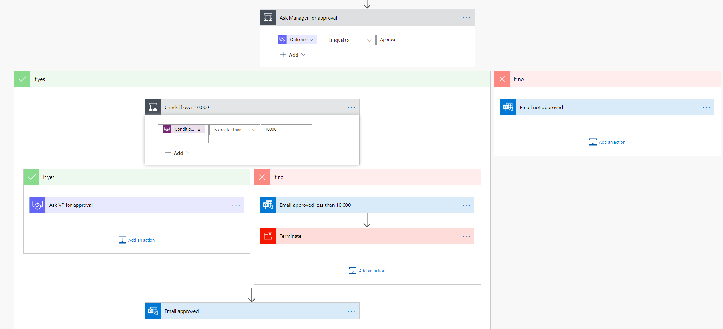
Example: Purchase order approval
Notes:
After the manager receives the approval and approves, the flow can then provide conditional logic. Typically this might be something like if the purchase order request is greater than $10,000 send it to VP if not then automatically approve the purchase order.
Here is an example of what this flow may look like.

Slide 11
Types of Power Automate flows
Event driven flows:
Flows built of a trigger to execute one or more actions
*Business process flows:
Flows built to augment the experience when using Model-driven apps and Microsoft Dataverse
UI flows:
Robotic process automation (RPA) flows allow you to row yourself performing actions on your desktop or within a web browser
Notes:
Event driven flows - These are flows that you build with a trigger and then one or more actions. There are a multitude of triggers and actions available, thanks to the existing connectors. You will see these as My flows and Team flows in Power Automate. The only difference between a My flow and a Team flow is ownership. With a My flow you are the sole owner, while a Team flow has more than one owner.
Business process flows - These flows are built to augment the experience when using Model-driven apps and the Microsoft Dataverse. Use these to create a guided experience in your Model-driven apps.
UI flows - These robotic process automation (RPA) flows allow you to row yourself performing actions on your desktop or within a web browser. You can then trigger a flow to perform that process for you. You can also pass data in or get data out of the process, letting you automate even "manual" business processes.
*As of August 2022, you can no longer create or manage business process flows from Power Automate outside of the solution explorer. Business process flows and instances continue to be supported through the solution explorer, Power Apps, and Dataverse table views.

Slide 12
Key concepts
Every flow has two main parts:
A Trigger:
The starting action of the flow such as new email arriving in your inbox or a new item being added to a SharePoint list
One or more Actions:
What you want to happen when a trigger is invoked such as start the action of creating a new file on OneDrive for Business
Notes:
Other examples of actions include sending an email, posting a tweet, and starting an approval.

Slide 13
Demo: Building a flow
Notes:
Use this opportunity to provide students with an overview of the application, and show them how to get to the different components. Show them how to create a Flow.

Slide 14
Exercise: Create your first flow
Follow the exercise in the student manual
Notes:
https://docs.microsoft.com/en-us/learn/modules/get-started-flows/2-create-first-flow

Slide 15
Exercise: Create recurring flows
Follow the exercise in the student manual
Notes:
https://docs.microsoft.com/en-us/learn/modules/get-started-flows/6-flow-scheduled-flows

Slide 16
Exercise: Exercise - Share flows
Follow the exercise in the student manual
Notes:
https://docs.microsoft.com/en-us/learn/modules/get-started-flows/8-flow-share-flows

Slide 17
Exercise: Troubleshoot flows
Follow the exercise in the student manual
Notes:
https://docs.microsoft.com/en-us/learn/modules/get-started-flows/9-troubleshoot-flows

Slide 18
Build more complex flows

Slide 19
Dynamic content

Slide 20
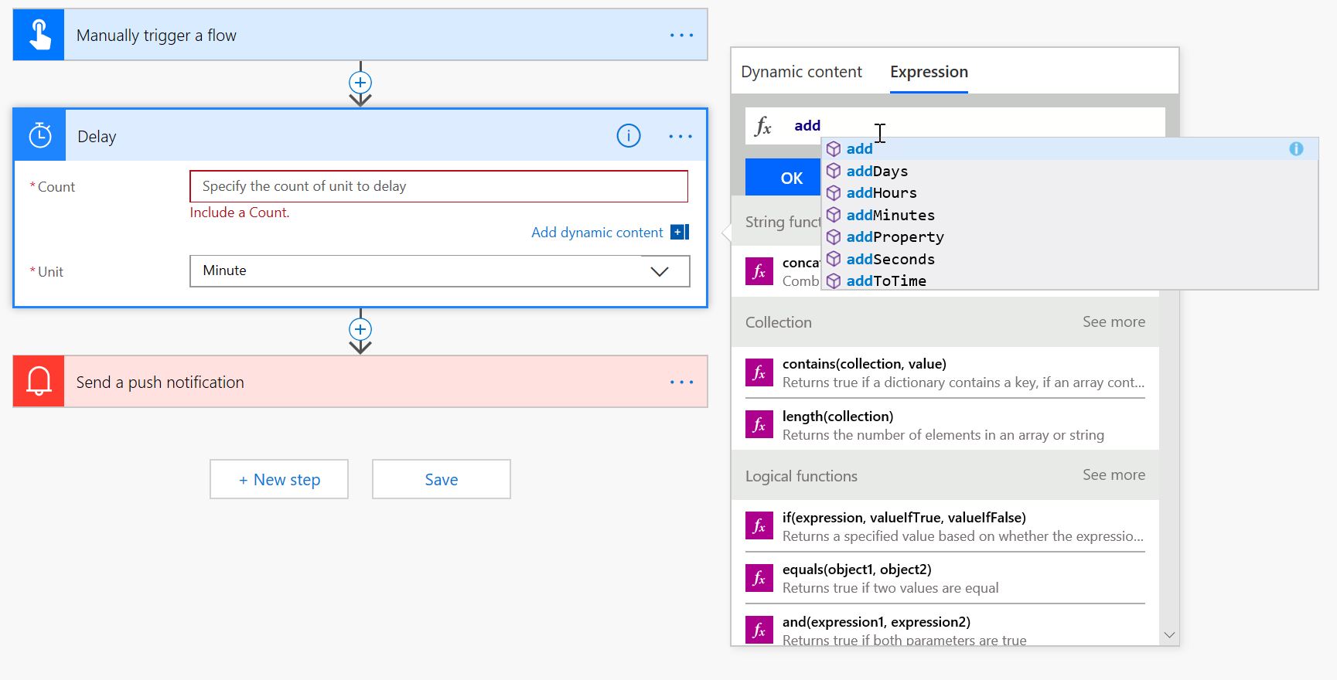
Expressions
Notes:
Many reasons to use expressions:
Convert types
Perform simple, inline calculations like string manipulation or arithmetic, or date/time manipulation
Generate data like the current time, a GUID or a random number
Handling optional values
“If” conditional statements / control flow
Working with lists

Slide 21
Exercise: Build an approval request
Follow the exercise in the student manual
Notes:
https://docs.microsoft.com/en-us/learn/modules/build-more-flows/2-flow-create-approval-request

Slide 22
Exercise: Build a flow that processes an approval
Follow the exercise in the student manual
Notes:
https://learn.microsoft.com/en-us/training/modules/build-approval-flows/3-process-approval-request

Slide 23
Exercise: Build a flow that runs at recurring time intervals
Follow the exercise in the student manual
Notes:
https://learn.microsoft.com/en-us/training/modules/build-approval-flows/4-recurring

Slide 24
Use the Admin center to manage environments and data policies in Power Automate

Slide 25
Administering flows
You can create a flow and perform administrative tasks in a browser or, if you download the Power Automate mobile app, on your phone:
Turn flows on or off from wherever you are
See when a flow has failed
Review detailed run history reports
View and filter runs by notification type
Notes:
You can create a flow and perform administrative tasks in a browser or, if you download the Power Automate mobile app, on your phone.
Here are some of the tasks you can perform with the mobile app:
Turn flows on or off from wherever you are.
See when a flow has failed.
Review detailed run history reports.
View and filter runs by notification type.

Slide 26
Administer flows
The Admin center is the central location where tenant admins and environment admins manage an organization’s data policies and environments:
Import and export flows
Share flows
Monitor flows
Notes:
Welcome to the Admin center! The Admin center is the central location where tenant admins and environment admins manage an organization's data policies and environments. Any changes that you make in the Admin center are immediately available to users in the organization.
In this module, you'll learn how to:
Import and export flows.
Share flows.
Monitor flows.

Slide 27
Environments
An environment is a space where you can store, manage, and share your organization’s business data, apps, and flows:
You can create separate environments to group the test and production versions of your apps
You can create separate environments that correspond to specific teams or departments in your company. Each environment holds the relevant data and apps for each team/ department
You can create separate environments for different global branches of your company
You can build all your apps in a single environment
Notes:
An environment is a space where you can store, manage, and share your organization's business data, apps, and flows. It also serves as a container to separate apps that might have different roles, security requirements, or target audiences.
The way that you use environments depends on your organization and the apps that you're trying to build. Here are some examples:
You can create separate environments to group the test and production versions of your apps.
You can create separate environments that correspond to specific teams or departments in your company. Each environment holds the relevant data and apps for each team/department.
You can create separate environments for different global branches of your company.
You can build all your apps in a single environment.

Slide 28
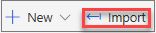
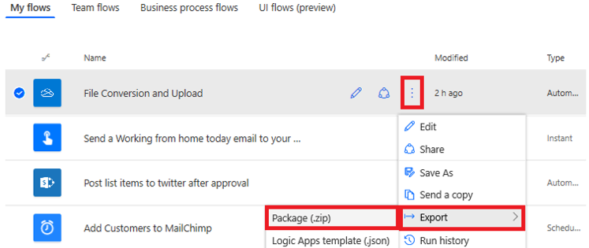
Export a flow
Import a flow:
After a flow has been exported, it can be imported by anyone that you send the zip file to.

Slide 29
Exercise: Export and import flows
Follow the exercise in the student manual
Notes:
https://docs.microsoft.com/en-us/learn/modules/administer-flows/2-flow-export-import

Slide 30
Exercise: Distribute button flows
Follow the exercise in the student manual
Notes:
https://docs.microsoft.com/en-us/learn/modules/administer-flows/3-share-flows

Slide 31
Introduction to expressions in Power Automate

Slide 32
Introduction to expressions
When you build a flow in Power Automate, it is easy to get started by adding a trigger and actions and then passing data between them with dynamic content.
In Power Automate, expressions are a set of simple functions that enable you to return data. Put simpler, you use expressions to write a formula to get your data the way you want it. Expressions allow you to do things like convert a date to UTC, divide two numbers, create that perfect string by combining columns, and much more all by using various functions.
Notes:
When you build a flow in Power Automate, it is easy to get started by adding a trigger and actions and then passing data between them with dynamic content. But, sometimes you need to do more. You want the ability to do a calculation or to transform data for your solution. To do these things, you can look to expressions.
In Power Automate, expressions are a set of simple functions that enable you to return data. Put simpler, you use expressions to write a formula to get your data the way you want it. Expressions allow you to do things like convert a date to UTC, divide two numbers, create that perfect string by combining columns, and much more all by using various functions.
Flows in Power Automate run on top of Azure Logic Apps. The most important reason for you to understand that is that they both use all of the same functions. When you are searching the internet for solutions or reading documentation about flow functions, it is common to end up looking at Logic Apps documentation. For example, the Reference Guide of functions for Power Automate is hosted on the Logic Apps side of the documentation.
Through the remainder of this module, you will learn about the different types of functions and the syntax so you can start to use expressions in your flows.

Slide 33
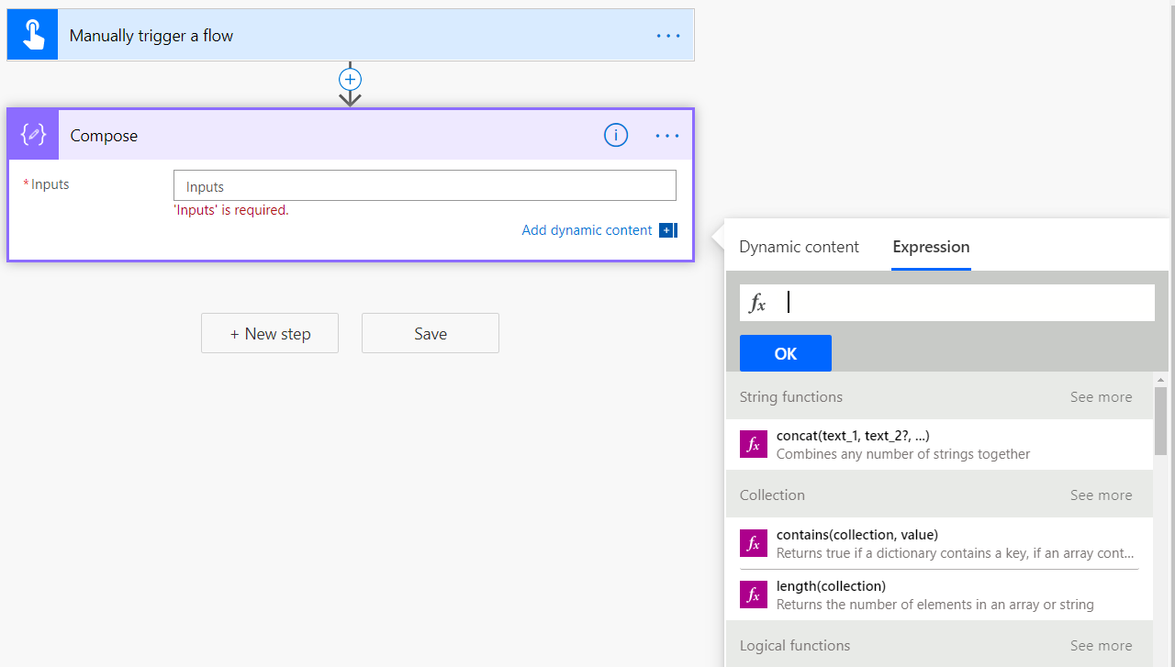
Get started with expressions
To write an expression in flow, you select in a column to open the Dynamic content menu and then you select "Expression" as shown below.
Notes:
To write an expression in flow, you select in a column to open the Dynamic content menu and then you select "Expression" as shown below.
[!div class="mx-imgBorder"] open the Dynamic content menu and select Expression
In the formula box, you will then write your expression by combining one or more functions. Before you learn about the different types of functions and their usage, there are some commonalities you should learn first. Function names are not case-sensitive.
[!TIP] Notice in the screenshot that we used a Manually triggers a flow trigger and a Compose action. This allows you to have a simple setup for writing and testing your expressions without worrying about other inputs or actions. Use this setup to follow along in this app or anytime you want to try out something new.

Slide 34
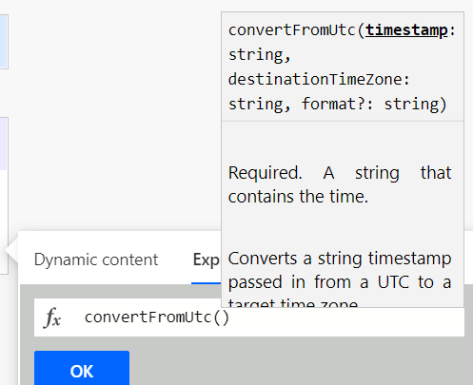
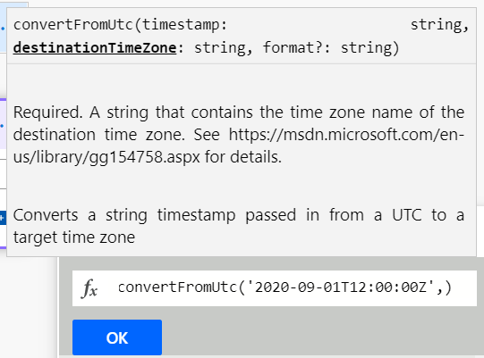
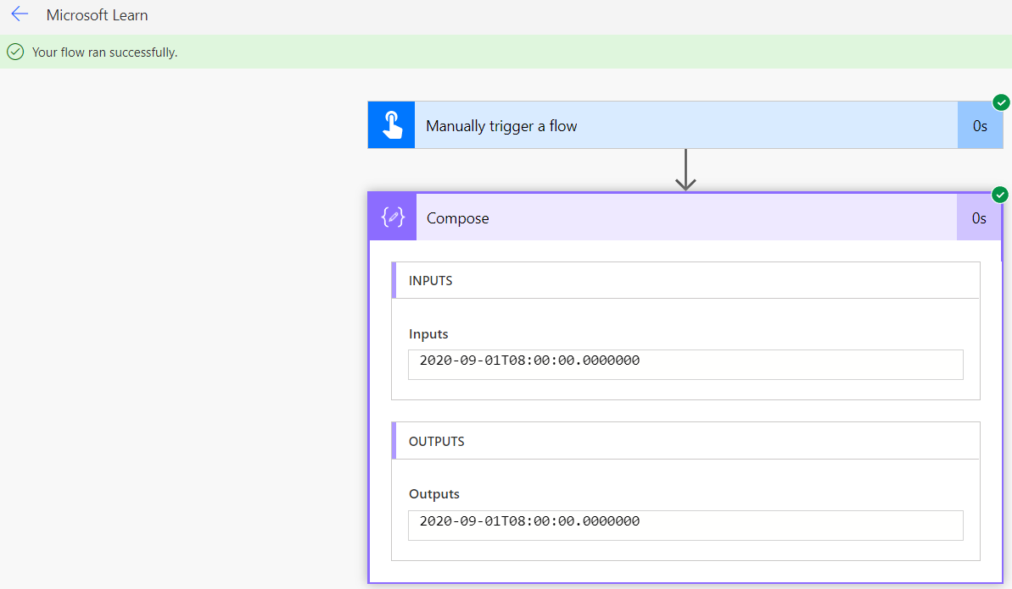
Auto suggest, hints, and links in the formula bar
Notes:
When you enter a function in the formula bar, you will see a pop-up with syntax suggestions.
Here you can see for the convertFromUtc function that it has two required inputs and one optional input. Timestamp is required and expects a string, destinationTimeZone is required and expects a string, and format? is optional and expects a string. Note the "?" at the end of format. That tells you it is an optional input.
After entering a Timestamp as a string typing a comma, then prompts for the destinationTimeZone:
This can be daunting. What does it want for the time zone? If you look in the pop-up, you'll see that it provides a link to the list of time zone values. This page provides you the string for the destinationTimeZone. With that information, we can now complete the expression.
convertFromUtc('2020-09-01T12:00:00Z','Eastern Standard Time')
With the complete formula, you can select OK to save your changes. Always be sure to select OK or UPDATE when editing an expression. If you select out of the inputs, you will lose your changes. Flow does not have autosave.
With your first expression complete, you can now select Test in the top right-hand corner. Then select Save & Test. select the Run flow button and then Done.
You should see the green bar that says "Your flow ran successfully." Expand the Compose action and you will see that the OUTPUTS is your date time converted to the new time zone.
Use this same process to see the output of any test expressions you create.

Slide 35
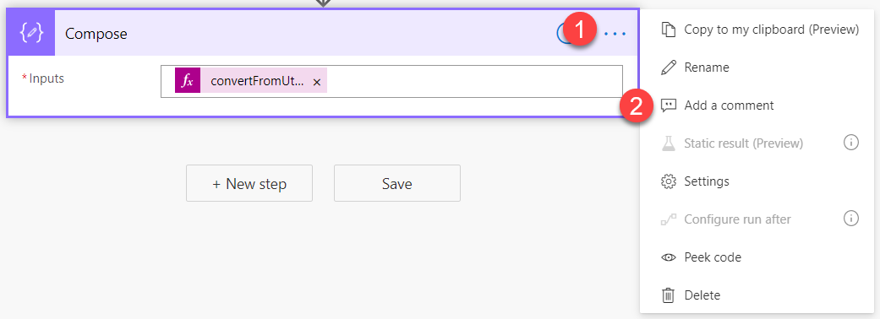
Comments make things easier
When you look at the convertToUtc expression you wrote earlier, you might notice that you need to scroll to see the whole formula in the function bar.
Notes:
When you look at the convertToUtc expression you wrote earlier, you might notice that you need to scroll to see the whole formula in the function bar. A common technique to make reviewing your expression easier is to use Comments and pasting the whole formula into the comment.
[!div class="mx-imgBorder"] paste the formula into the comment
To add a comment, select the ellipse to show the menu. Then select "Add a comment".
[!div class="mx-imgBorder"] select the ellipsis and "add a comment"
Then you can enter any text you want. This could either be text or just a copy and paste of your expression as shown previously.

Slide 36
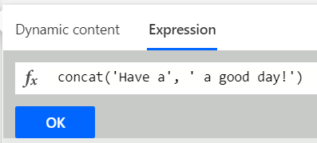
Defining text
When you use text in a flow expression, you will use the ' (single quote) at the beginning and end of each string.
Code
Concat('Have a', ' good day!')
Notes:
When you use text in a flow expression, you will use the ' (single quote) at the beginning and end of each string. For example, if you wanted to combine the string "Have a" and "good day!" in an expression, you would use the Concat function and your syntax would be:
Concat('Have a', ' good day!')
[!div class="mx-imgBorder"] concat function syntax
These little details will help you more effectively work with expressions. One of the great things about expressions is that they are consistent and as you learn about one function you can often apply those learnings to the next function, rapidly speeding up your learning.

Slide 37
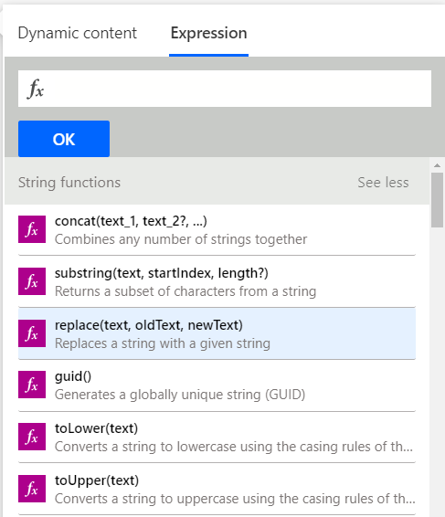
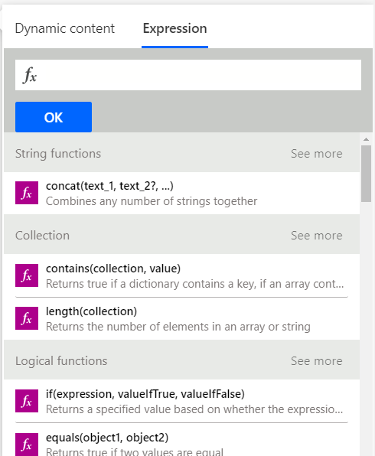
Types of functions
Functions are grouped into 10 different categories like math and logic.
Notes:
Functions are grouped into 10 different categories like math and logic. The categories are just a logical organization to making finding the function you need easier. Below you will get an overview of each category and some examples.
Keep in mind as you go through the various examples, we use static text and values. This is to allow you to test and recreate the examples as easily as possible. In your flows, you may substitute dynamic content in place of this static data. Just ensure that your dynamic data is the correct format for the function.
In the screenshot below, you will notice to the right of each category header (like String functions or Collection) the words "See more." By selecting "See more," the complete list of functions for that category will be shown.
[!div class="mx-imgBorder"] See more for complete list of functions
Select See more beside String functions.
[!div class="mx-imgBorder"] String functions see more

Slide 38
String functions
String (text) functions are used to modify strings, find characters in a string, format strings, and more.
Power Apps Formula
formatNumber(12.5,'C’)
formatNumber(12.5,'C','ja-JP')
Notes:
String (text) functions are used to modify strings, find characters in a string, format strings, and more. Text manipulation is a core skill often used when trying to better format or modify data you received from somewhere else.
An example of a string function is the formatNumber function. This function can convert a number into a string in a given format. A common request is to make a string look like currency. To change the number 12.5 into $12.50, use the following formula:
formatNumber(12.5,'C')
The C represents the Currency numeric format string. Don't worry, a list of the other options are available at Standard numeric format strings. You also might be asking what if you wanted to show the number as currency but with the Yen symbol? There is an optional parameter where you can pass the locale.
formatNumber(12.5,'C','ja-JP')
This formula will return ?13.

Slide 39
Collection functions
These functions are used for arrays and strings.
Code
length('I love Power Automate.')
Notes:
These functions are used for arrays and strings. They may be used to check if an array is empty, to grab the first, or last item, or even for join, union, and intersection operations.
An example of a helpful Collection function is length. You can use length to return the number of items in a string or array. The following example would be used to count the number of characters in the string "I love Power Automate."
length('I love Power Automate.')
The output would be 22. You can use this type of function for validation or in conjunction with the String functions to manipulate strings.

Slide 40
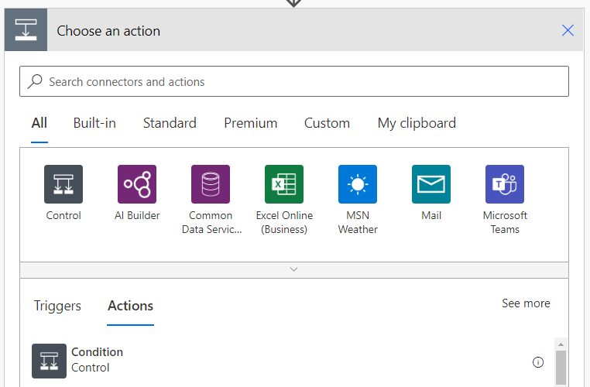
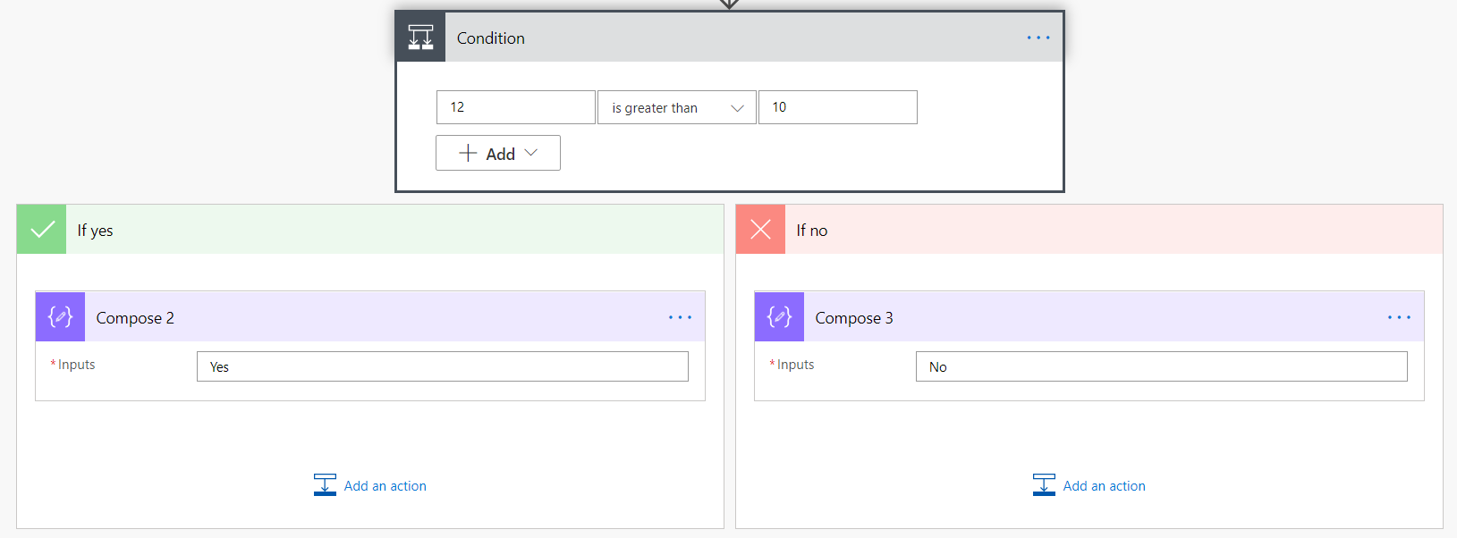
Logical functions
These functions are used to work with conditions, to compare values, and to do other logic-based evaluations.
Code
If(greater(12,10),'Yes','No')
Notes:
These functions are used to work with conditions, to compare values, and to do other logic-based evaluations. These are often thought of as If statements where you want to compare if a number is greater than another number. Flow supports all of the logical comparisons you would expect.
In the example below, an expression will compare if 12 is greater than 10 and then output the appropriate string. This will also be your first expression that uses more than one function. We will combine if and greater logical functions.
If(greater(12,10),'Yes','No')
The result of this expression would be the string "Yes". To understand the expression, work from the inside out. Greater(12,10) returns true or false depending on if 12 is greater than 10. Since it is, the value returned is true.
Now that you know the answer is true, you can see that the If function returns the data after the first comma. In this case that is the string "Yes". Had it been false then the string "No" would have been returned.
[!IMPORTANT] While you can write logical expressions as shown above, there is also an action called Condition that lets you write If statements without an expression.
[!div class="mx-imgBorder"] condition to write if statements without an expression
Here is the same condition written using the action.
[!div class="mx-imgBorder"] condition written using the action
You will find over time that you use a combination of both methods depending on your requirements.

Slide 41
Conversion functions
Power Apps Formula
These functions are used to change the type of your data.
Power Apps Formula
Int('12’)
Float('12.4’)
If(greater(Int('12'), Float('12.4')),'Yes','No')
Notes:
These functions are used to change the type of your data. This can be simple things like converting a text number into an integer, or more complex functions like changing the encoding of a file from base64 to binary. Knowing that these functions are available will help you overcome problems you encounter when getting your data shaped correctly.
A common scenario is the need to use int or float to change a text number into an actual number. This is common when importing data into your flow from a data source. The number 12 or 12.4 may be stored as text. In order to use that number in a logical function or write it to a location that expects a number, you will need to covert it. The following example changes the string "12" into the integer 12.
Int('12')
That will output the integer 12. Had it been the string "12.4" then you would need to convert it to a float because of the decimal digits. In that case you would use
Float('12.4')
Now you could use text number to do the previous example.
If(greater(Int('12'), Float('12.4')),'Yes','No')
This would output the string "No" because 12 is not greater than 12.4. Combining functions like this is common and is a useful pattern to learn.

Slide 42
Math functions
Math functions do exactly as you would expect.
Power Apps Formula
Add(12, 13)
add(add(12,13),15)
Notes:
Math functions do exactly as you would expect. They allow you to add, subtract, multiply, and perform other similar functions. In addition, Math functions allow you to find the smallest and largest numbers of several numbers or get a random number, amongst other things.
One thing to keep in mind is that there is a different function for adding numbers (add) and for subtracting numbers (sub). Many formula languages add negative numbers to produce subtraction, but flow does not. To add two numbers together, you use the following:
Add(12, 13)
This would return 25. If you wanted to add three numbers, then you would need to add a second function like so:
add(add(12,13),15)
This would return 40. As you have seen before, you will often find yourself nesting functions to get your desired results.

Slide 43
Date and time functions
These functions are used to return the current date and time, change time zones, find specific info about a date and time, and do other date/time manipulations.
Code
convertFromUtc(utcNow(), 'Eastern Standard Time', 'dd-MM-yyyy hh:mm tt' )
Notes:
These functions are used to return the current date and time, change time zones, find specific info about a date and time, and do other date/time manipulations. If you have date and time values in your data, you'll need these functions.
One important thing to remember as you explore date and time functions in flow is that they are often based on UTC. Most data sources pass data back and forth with flow in UTC format. Also, if you use the function UTCNow() that will return the current time in UTC format. If you want to use that to compare to user data that is currently in the Eastern Time Zone, then you will need to use the following formula to convert it:
convertFromUtc(utcNow(), 'Eastern Standard Time', 'dd-MM-yyyy hh:mm tt' )
This will output 01-09-2020 05:39 PM. For a complete list of the date time format options, review Custom date and time format strings.

Slide 44
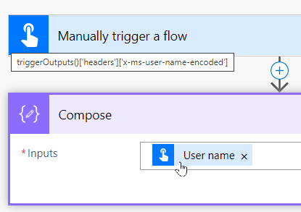
Referencing functions
The referencing functions are used to work with the outputs of your actions and triggers.
Code
triggerOutputs()['headers']['x-ms-user-name-encoded']
Notes:
The referencing functions are used to work with the outputs of your actions and triggers. The nice thing is that the majority of the time, flow will write these functions for you. When you add dynamic content to your flow, you are using referencing functions without knowing it. If you add dynamic content and then hover of that content, you can see this in action.
In the screenshot below, by adding the User name dynamic content from my trigger to the Inputs for Compose you can see this in action.
[!div class="mx-imgBorder"] add user name dynamic content from trigger
By hovering over User name with the mouse pointer, you can see
triggerOutputs()['headers']['x-ms-user-name-encoded']
Flow created the expression using the triggerOutputs for you. It is the pulling from the Headers property the x-ms-user-name-encoded property. Most of the time in flow you will reference these properties via dynamic content. But it is possible to write your own expressions to recreate this if necessary. Each trigger and action will have different formats for how you retrieve their data.
Explore these functions by adding different triggers, actions, data sources, and apply-to-each loops in your flow. Then, use their properties as dynamic data to see more examples. The good news is writing these types of expressions is not common.

Slide 45
Workflow functions
The workflow functions are used to retrieve information about your flow and are closely related to the referencing functions.
Code
Workflow().run.id
Notes:
The workflow functions are used to retrieve information about your flow and are closely related to the referencing functions. One of the functions is called workflow. You can use it as shown below.
Workflow().run.id
This will return the ID of the current flow run. You could use this for error reporting or logging if needed. These functions are not commonly used.

Slide 46
URI parsing functions
These functions are used to dissect a URI that is passed in as a string.
Code
uriQuery('https://flow.microsoft.com/fakeurl?Test=Yes')
Notes:
These functions are used to dissect a URI that is passed in as a string. You may use these functions to find the host, path, query string or other portions of the URI. The following example shows you how to use uriQuery to get the query string portion of the given URI.
uriQuery('https://flow.microsoft.com/fakeurl?Test=Yes')
This would return the string "?Test=Yes" which you could then parse with string functions to get the value passed in from the URI.

Slide 47
Manipulation functions
Manipulation functions are used to work with specific objects in your flow.
Code
Coalesce(null, 'Power Automate', 'Power Apps')
Notes:
Manipulation functions are used to work with specific objects in your flow. You can do things such as find the first non-blank value, work with properties, or find xpath matches. These functions are used typically in JSON or XML nodes evaluations.
One function you may find handy here is coalesce. This function will allow you to find the first non-null value from a specified set of values. You use the function as shown in the following formula:
Coalesce(null, 'Power Automate', 'Power Apps')
This formula would return the string "Power Automate". Handy when you are passing in multiple values and want to find the first one that is not null.

Slide 48
Exercise: Creating a manual flow and using expressions
Follow the exercise in the student manual

